Slide 1

Ethics in Information Technology, Third Edition
Chapter 5
Freedom of Expression

Slide 2
Objectives
As you read this chapter, consider the following questions:
  What is the basis for the protection of freedom of expression in the United States, and what types of expression are not protected under the law?
  What are some key federal laws that affect online freedom of expression, and how do they impact organizations?
  What important freedom of expression issues relate to the use of information technology?
Ethics in Information Technology, Third Edition

Slide 3
First Amendment Rights
Right to freedom of expression
  Important right for free people everywhere
  Guaranteed by the First Amendment
Definition of free speech includes:
  Nonverbal, visual, and symbolic forms of expression
  Right to speak anonymously
Ethics in Information Technology, Third Edition

Slide 4
First Amendment Rights (cont’d.)
Not protected by the First Amendment:
  Perjury
  Fraud
  Defamation
  Obscene speech
  Incitement of panic
  Incitement to crime
  “Fighting words”
  Sedition
Ethics in Information Technology, Third Edition

Slide 5
Obscene Speech
Speech is considered obscene when:
  Average person finds the work appeals to the prurient interest
  Work depicts or describes sexual conduct in an offensive way
  Lacks serious literary, artistic, political, or scientific value
Ethics in Information Technology, Third Edition

Slide 6
Defamation
Publication of a statement of alleged fact that is:
  False
  Harms another person
    Harm is often of a financial nature
Slander
  Oral defamatory statement
Libel
  Written defamatory statement
Ethics in Information Technology, Third Edition

Slide 7
Freedom of Expression: Key Issues
Controlling access to information on the Internet
Anonymity on the Internet
Defamation
Hate speech
Corporate blogging
Pornography
Ethics in Information Technology, Third Edition

Slide 8
Controlling Access to Information on the Internet
Freedom of speech on the Internet is complicated by children’s access
Communications Decency Act (CDA)
  Aimed at protecting children from pornography
  Broad language and vague definition of indecency
  Found unconstitutional in 1997
Ethics in Information Technology, Third Edition

Slide 9
Controlling Access to Information on the Internet (cont’d.)
Child Online Protection Act (COPA)
  Applies to communication for commercial purposes
  Imposes penalties for exposing minors to harmful material on the Web
  Found unconstitutional in 2004
Internet filtering
  Software installed with a Web browser
  Blocks access to certain Web sites that contain inappropriate or offensive material
Ethics in Information Technology, Third Edition

Slide 10
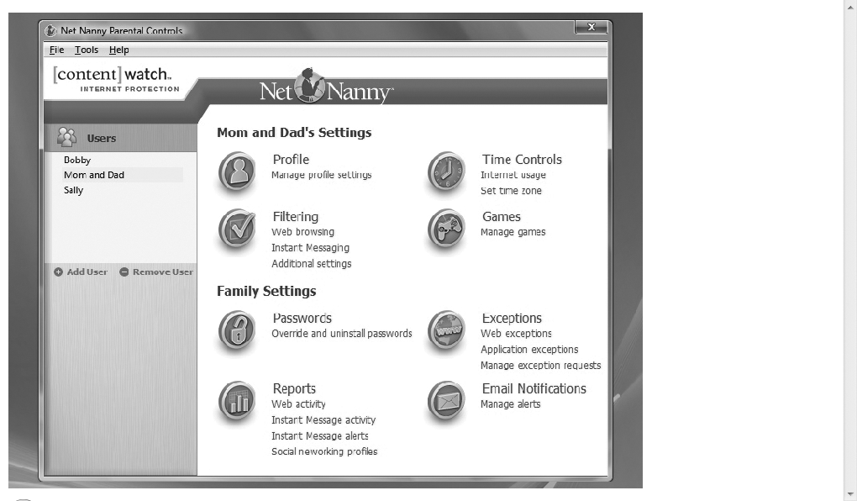
Controlling Access to Information on the Internet (cont’d.)
Ethics in Information Technology, Third Edition

Slide 11
Controlling Access to Information on the Internet (cont’d.)
URL filtering
  Blocks objectionable URLs or domain names
Keyword filtering
  Blocks key words or phrases
Dynamic content filtering
  Web site’s content is evaluated immediately before being displayed
  Uses
    Object analysis
    Image recognition
Ethics in Information Technology, Third Edition

Slide 12
Controlling Access to Information on the Internet (cont’d.)
Top-rated Internet filters for home users
  NetNanny 6.0
  Safe Eyes
  CYBERsitter
  WiseChoice.net
  CyberPatrol
Additional filters
  ADL HateFilter (Anti-Defamation League)
  ICRA (Family Online Safety Institute)
Ethics in Information Technology, Third Edition

Slide 13
Controlling Access to Information on the Internet (cont’d.)
ICRA rating system
  Questionnaire for Web authors
  Generates a content label
    Platform for Internet Content Selection (PICS)
  Users configure browsers to read the label
  Relies on Web authors to rate their site
  Complement to other filtering techniques
Ethics in Information Technology, Third Edition

Slide 14
Controlling Access to Information on the Internet (cont’d.)
ISP blocking
  Blocking is performed on the ISP server
  ClearSail/Family.NET prevents access to certain Web sites
Ethics in Information Technology, Third Edition

Slide 15
Legal Overview: Children’s Internet Protection Act (CIPA)
Federally financed schools and libraries must block computer access to:
  Obscene material
  Pornography
  Anything considered harmful to minors
Schools and libraries subject to CIPA do not receive Internet access discounts unless they certify that Internet safety measures are in place
  Required to adopt a policy to monitor the online activities of minors
Ethics in Information Technology, Third Edition

Slide 16
Legal Overview: Children’s Internet Protection Act (CIPA) (cont’d.)
CIPA does not require the tracking of Internet use by minors or adults
Acceptable use policy agreement is an essential element of a successful program in schools
  Signed by:
    Students
    Parents
    Employees
Ethics in Information Technology, Third Edition

Slide 17
Legal Overview: Children’s Internet Protection Act (CIPA) (cont’d.)
Difficulty implementing CIPA in libraries because their services are open to people of all ages
  Including adults with First Amendment rights
Ethics in Information Technology, Third Edition

Slide 18
Anonymity on the Internet
Principle of anonymous expression
  People can state opinions without revealing their identity
  In the wrong hands, it can be a tool to commit illegal or unethical activities
Anonymous remailer service
  Computer program that strips the originating address from the e-mail message
  Forwards the message to the intended recipient
  Ensures no header information can identify the author
Ethics in Information Technology, Third Edition

Slide 19
Anonymity on the Internet (cont’d.)
John Doe lawsuit
  Identity of the defendant is temporarily unknown
  Common in Internet libel cases
  Defendant communicates using a pseudonym or anonymously
  ISPs subpoenaed to provide the identity
  By filing a lawsuit, the company gains immediate subpoena power
Ethics in Information Technology, Third Edition

Slide 20
Defamation and Hate Speech
Actions that can be prosecuted include:
  Sending threatening private messages over the Internet to a person
  Displaying public messages on a Web site describing intent to commit acts of hate-motivated violence
  Libel directed at a particular person
Ethics in Information Technology, Third Edition

Slide 21
Defamation and Hate Speech (cont’d.)
Some ISPs voluntarily agree to prohibit subscribers from sending hate messages
  Does not violate subscribers’ First Amendment rights because these prohibitions are in the terms of service
  ISPs must monitor the use of their service
  Take action when terms are violated
Ethics in Information Technology, Third Edition

Slide 22
Corporate Blogging
Some organizations allow employees to create their own personal blogs to:
  Reach out to partners, customers, and employees
  Improve their corporate image
Blogs can provide uncensored commentary and interaction
  Criticism of corporate policies and decisions
Could involve risk that employees might:
  Reveal company secrets
  Breach federal security disclosure laws
Ethics in Information Technology, Third Edition

Slide 23
Pornography
The Internet has been a boon to the pornography industry
  More than 4.2 million porn Web sites are accessible
  The sites generate an estimated $4.9 billion a year in revenue
  72 million estimated visitors to porn Web sites monthly
CAN-SPAM Act
  Deterrent in fighting the dissemination of pornography
Ethics in Information Technology, Third Edition

Slide 24
Pornography (cont’d.)
Reasonable steps to stop access in the workplace
  Establishing a computer usage policy that prohibits access to pornography sites
  Identifying those who violate the policy
  Taking action against those users
Numerous federal laws address child pornography
  Federal offense to produce or distribute
  Most states outlaw possession as well
At least 7 states require computer technicians to report child pornography on clients’ computers
Ethics in Information Technology, Third Edition

Slide 25
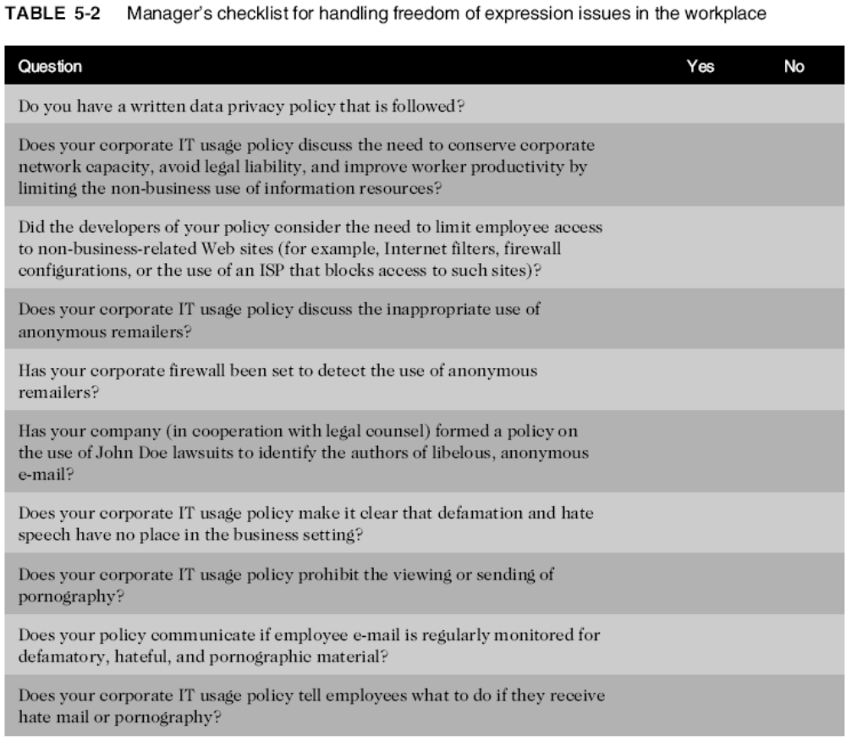
Ethics in Information Technology, Third Edition

Slide 26
Summary
First Amendment protects the right to:
  Freedom of religion and expression
Does not protect obscene speech, defamation
Key issues
  Controlling access to Internet information, especially for children
  Anonymous communication
  Spread of defamation and hate speech
  Access to pornography
  CAN-SPAM Act limitations on e-mail messages
Ethics in Information Technology, Third Edition

